Slide 1
Employee Career Survey Using Python
An in-depth analysis of education trends, work preferences.

Slide 2
Project Objective
The main objective of this analysis is to investigate the most important factors that affect the career goals of employees, particularly Gen Z, and detect education trends, work preferences, and turnover rates based on Python.

Slide 3
Data Cleaning
(Pandas & NumPy Library): Pandas was employed for data manipulation, missing value management, and organizing the dataset for efficient analysis. NumPy was employed for numerical calculations, facilitating fast data processing and conversion.

Slide 4
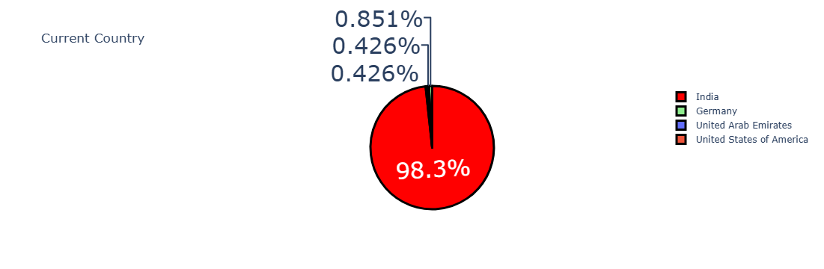
Data Analysis
➡️ What is the analysis of the country?
✔ Our analysis shows that India has the maximum number of employees, which can imply a requirement for further segmentation by certain areas in India in future analyses.

Slide 5
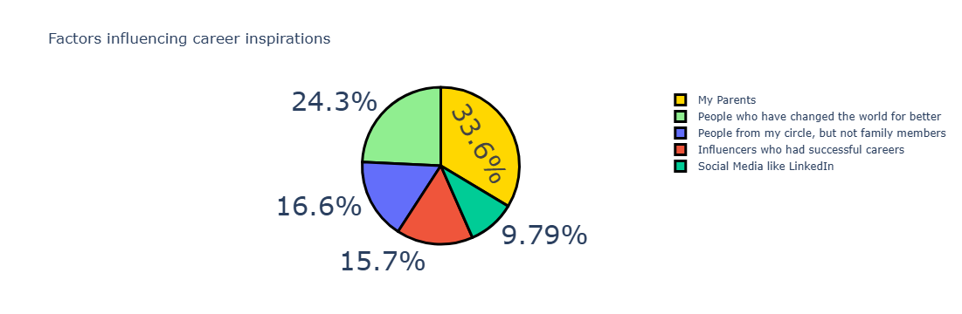
Data Analysis
➡️ What are the factors influencing the career aspirations of Genz?
✔ Parental influence is a very important factor that affects career choice for GenZ.

Slide 6
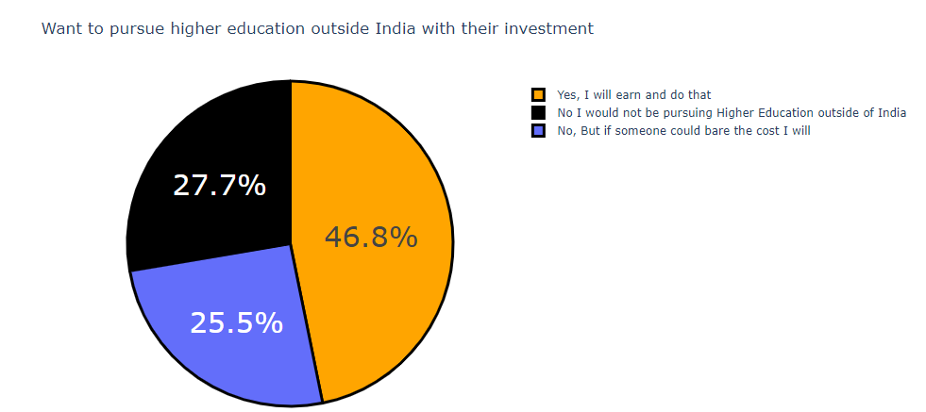
Data Analysis
➡️ How many want to pursue higher education outside India with their investment?
✔ 46.8% of workers are interested in investing in studying higher education abroad, whereas 27.7% are not.

Slide 7
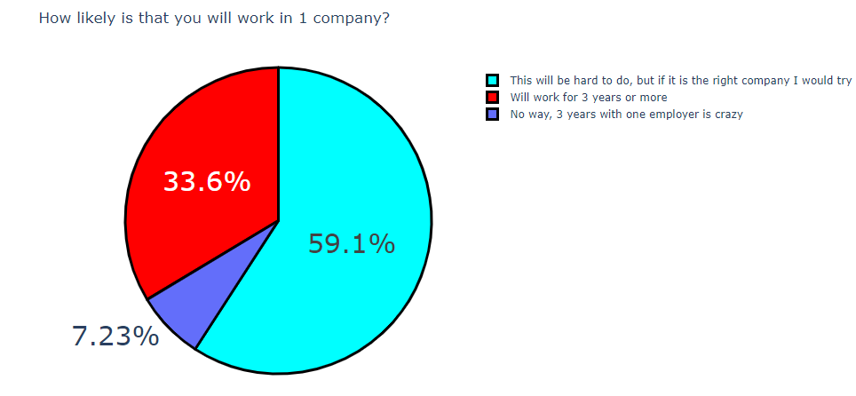
Data Analysis
➡️ How likely Genz is to work for One Company for three years or more?
✔ 59% of Gen Z workers find it difficult to remain at a company for over three years.

Slide 8
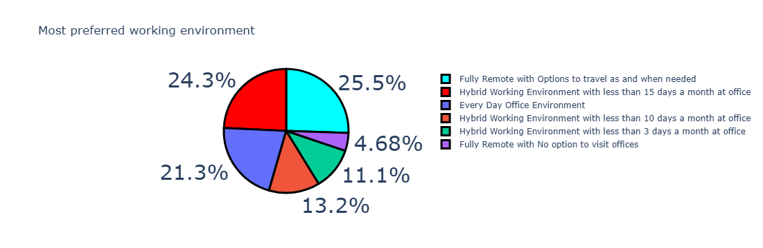
Data Analysis
➡️ What is the preferred working environment of Genz?
✔ Most employees want flexible work arrangements, with 25.5% wanting fully remote with travel options, 24.3% wanting a hybrid model (≤15 days in-office), and 21.3% wanting a daily office setup, while smaller segments want hybrid models with less in-office days or fully remote with no office access.

Slide 9
Data Visualization
(Plotly Library): Used Plotly library to produce meaningful pie charts.

Slide 10
Conclusion
Gen Z's career choices are highly driven by family, education prospects, and work environment and organizations need to prioritize engagement, flexibility, and learning opportunities to attract and retain young talent.

